Slide 1
AI Lab Assignment Week 5 Assignment 4
By –Undefined Group
202051009 Ade Eshwar Nayak
202051028 Ankit Kumar Mishra
202051073 Ghiya Jay Manishbhai
202051080 Hariom Kaushal

Slide 2
Lab Assignment 4
Minimax
Alpha – Beta Pruning

Slide 3
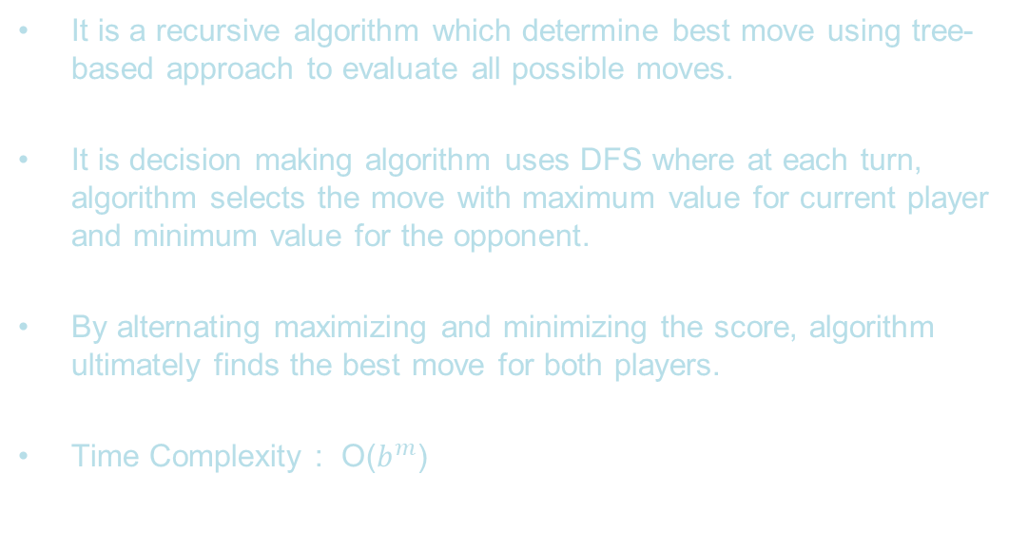
Minimax Algorithm
It is a recursive algorithm which determine best move using tree-based approach to evaluate all possible moves.
It is decision making algorithm uses DFS where at each turn, algorithm selects the move with maximum value for current player and minimum value for the opponent.
By alternating maximizing and minimizing the score, algorithm ultimately finds the best move for both players.
Time Complexity : O($b^{m}$)

Slide 4
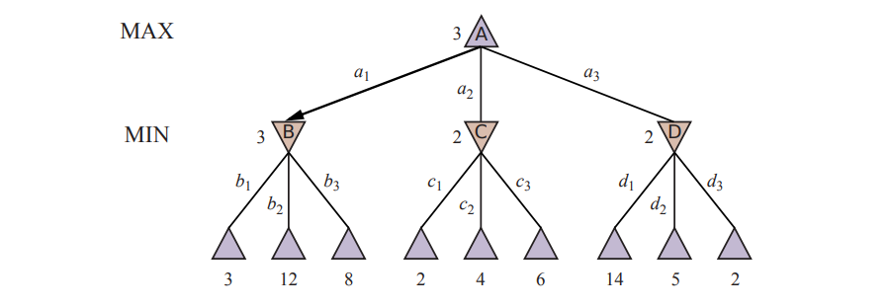
Algorithm
Start with the root node of the game tree and evaluate the value of its children.
If the node is a maximizing player, choose the move with the maximum value. If the node is a minimizing player, choose the move with the minimum value.
If the node is a terminal node, return its value.
Repeat the process for the selected child node, alternating between maximizing and minimizing players until a terminal node is reached.
The final value returned by the algorithm is the value of the root node, which represents the best move for the current player.

Slide 5
Can handle complex decision-making situations by considering all possible moves and counter-moves in a game.
It has slow computation time so unable to handle large game trees so can handle uncertainty as select all possible scenarios and selecting the best move based on the minimax values.
Impractical for large game trees due to the exponential growth of the tree.
It always selects the best move for the maximizing player, assuming the other player is playing optimally.

Slide 6
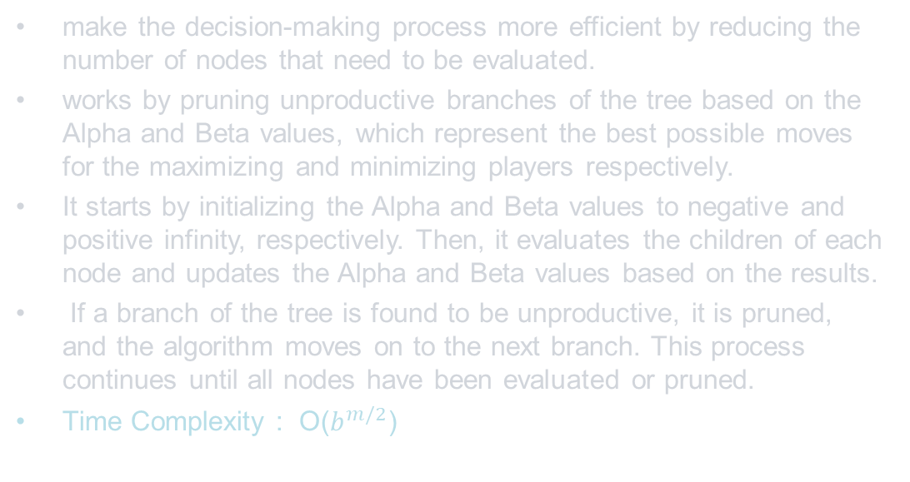
Alpha – Beta Pruning
make the decision-making process more efficient by reducing the number of nodes that need to be evaluated.
works by pruning unproductive branches of the tree based on the Alpha and Beta values, which represent the best possible moves for the maximizing and minimizing players respectively.
It starts by initializing the Alpha and Beta values to negative and positive infinity, respectively. Then, it evaluates the children of each node and updates the Alpha and Beta values based on the results.
If a branch of the tree is found to be unproductive, it is pruned, and the algorithm moves on to the next branch. This process continues until all nodes have been evaluated or pruned.
Time Complexity : O($b^{m/2}$)

Slide 7
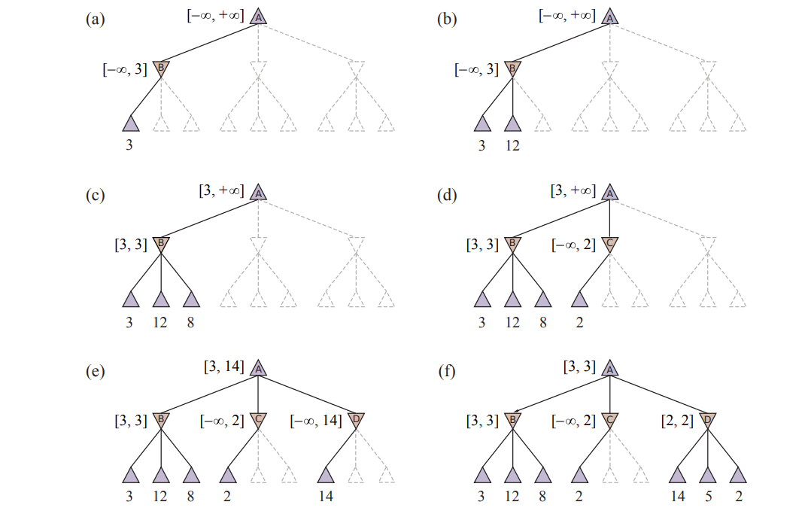

Slide 8
Problems
What is the size of the game tree for Noughts and Crosses? Sketch the game tree.
Read about the game of Nim (a player left with no move losing the game). For the initial configuration of the game with three piles of objects as shown in Figure, show that regardless of the strategy of player-1, player-2 will always win. Try to explain the reason with the MINIMAX value backup argument on the game tree.
Implement MINIMAX and alpha-beta pruning agents. Report on number of evaluated nodes for Noughts and Crosses game tree.
Use recurrence to show that under perfect ordering of leaf nodes, the alpha-beta pruning time complexity is O(b^{m/2}), where b is the effective branching factor and m is the depth of the tree.

Slide 9
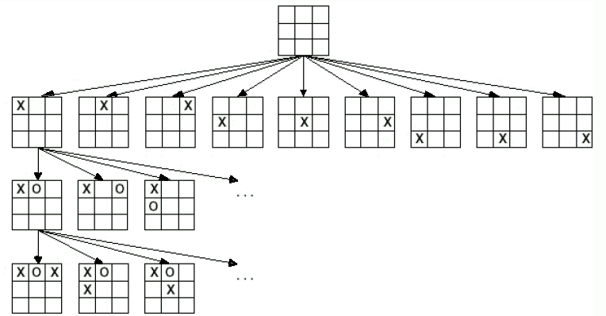
1. What is the size of the game tree for Noughts and Crosses? Sketch the game tree.

Slide 10
is a two-player strategy game
is a 3 X 3 empty boarded game.
Initially, have 9 possible ways.
Then for each possible way, have 8 possible ways.
Then it has 7,6,5,4,3,2,1 possible ways.
For 3 X 3 matrix, we have approx. 10 lakhs possibilities.
Effectively, after winning any player game ends, so final possibilities are 5.5 lakhs.

Slide 11
2. Game of Nim
It is a game of Nim is a two-player game of strategy.
The game is played by taking turns to remove one or more objects from a single pile.
A player left with no move losing the game.
Nim is considered a game of perfect information, meaning that both players have complete information about the game state at all times, including the number of objects in each pile.

Slide 12
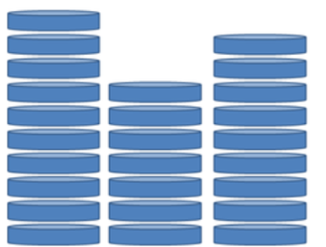
NOTE :
The winning in the Nim game depends on the two factor:
• One who starts the game
• Initial configuration of game
Initial Configurations : [10,7,9] for the image.
From the code we implemented for this problem using minimax algorithm, we found out that for this initial configuration Player 1 will always winning the game.
Which is CONTRADICTING from our PROBLEM
STATEMENT where Player 2nd supposed to win.

Slide 13
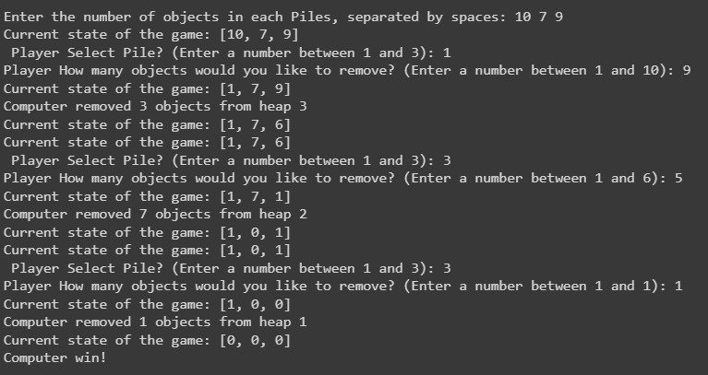
Output

Slide 14
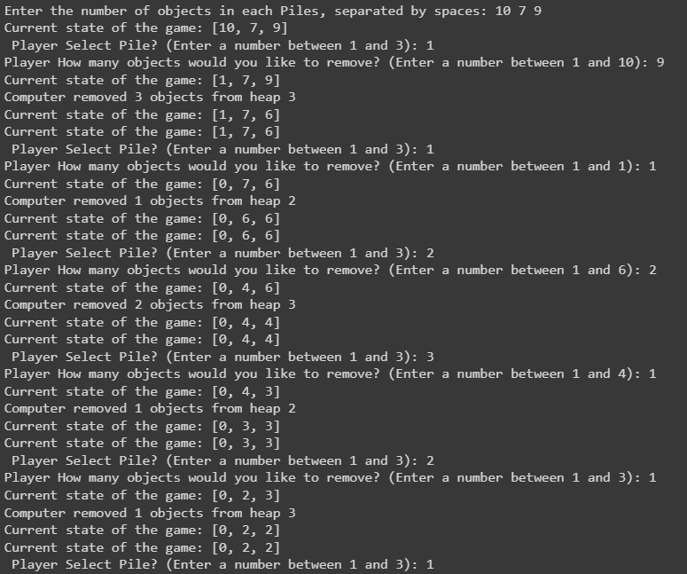
Output

Slide 15
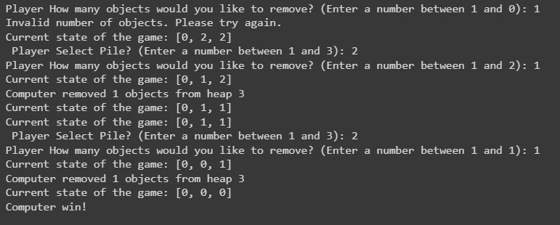
Output

Slide 16
XOR Trick for Game of NIM
From our further search we came across the trick that if “XOR” of Initial configurations of piles is “0” then Player 2 always win if Player 2 plays optimally.
And similarly, if “XOR” is non-zero then Player 1 always win if plays optimally.

Slide 17
3. MINIMAX and alpha-beta pruning agents for Tic-Tac-Toe
MiniMax Agent we assume that whoever is playing game against AI agent will play optimally.
We will +first go to the leaf node of current state
Then evaluate the utility value from utility function for that leaf node.
Then on basis of who’s turns is, we will obtain best possible cases for Min or Max agents
Similarly following these steps we will calculate best possible move .

Slide 18
With Alpha Beta Pruning
In this we will maintain two variables for Min/Max agent.
If anywhere we found that alpha >= beta then we will not calculate its other sub tree this called pruning of node.
So from this we can calculate best possible move in much faster times by reducing the number of node visited

Slide 19

4. Use recurrence to show that under perfect ordering of leaf nodes, the alpha-beta pruning time complexity is O(b^{m/2}), where b is the effective branching factor and m is the depth of the tree.
Minimax (TC) : T(m)= b.T(m-1) + c
T(m)= O($b^{m}$)
Alpha beta pruning (TC) : T(m)=T(m-1)+ (b-1)T(m-2) + c.
T(m)= O($b^{m/2}$)

Slide 20
For best ordering of nodes, what we absolutely have to compute is the correct value of first child and prove it.
To prove it, for every remaining child, at least do one of their children.
So in effective pruning, if we can effectively search for twice of depth.

Slide 21
Thank You By –undefined Group

